Slide 1

Date: | Human Biology Year 12 ATAR
Do Now Past exam question Body Fluid homeostasis Lesson Agenda 1: Do Now 2: Blood Gas Homeostasis 3: Lesson summary and wind-up Suggested Study Complete review worksheet, mark and correct using answer key on Connect. Read through today’s notes and textbook section NEXT LESSON Past Exam Question Disruptions to homeostasis | Learning Aims: Summarise how gas exchange occurs in the body between environment, bloodstream and cells. Describe the nerve and muscle pathways involved in breathing. Discuss how CO₂ concentration impacts blood pH. Understand that CO₂ concentration and its effect on pH are the major stimulus for regulation of respiratory rate. Discuss how homeostasis is maintained when CO₂ levels rise. Draw a detailed, annotated feedback loop (steady state control model) to show how homeostasis is maintained when CO₂ levels rise. Discuss how homeostasis is maintained when CO₂ levels fall. Draw a detailed, annotated feedback loop (steady state control model) to show how homeostasis is maintained when CO₂ levels fall. Discuss the role of O₂ concentration in regulating blood gas levels and respiratory rate Describe the nerve pathways involved in voluntary control of breathing, and why voluntary control is limited. Discuss physiological mechanisms involved in shallow water blackout. Discuss physiological mechanisms involved in “oxygen debt” after exercise.
 | Key Vocabulary Chemoreceptor Carotid Body Aortic Body Respiratory Rate

Slide 2
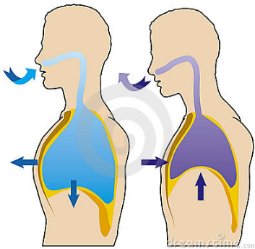
Regulation of Gas Concentrations
Chapter 6 Human Perspectives

Slide 3
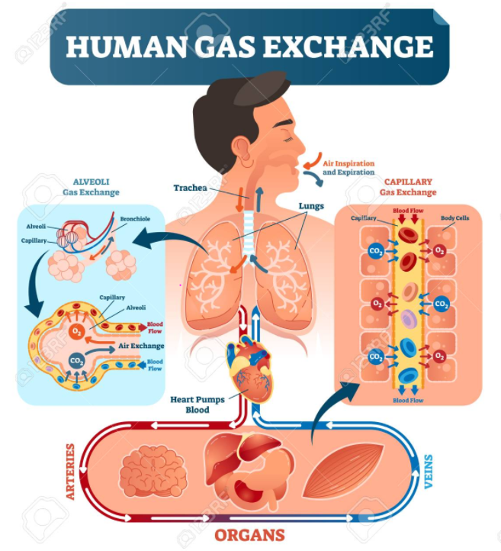
Overview
For homeostasis, cells need:
Continuous supply of oxygen (used in cellular respiration)
Ability to excrete carbon dioxide waste
Levels of O₂ and CO₂ in the blood must be regulated.
Respiratory and Circulatory systems work together to do this.
Respiratory system allows:
Intake of O₂ from environment
Excretion of CO₂ from body
Cardiovascular/Circulatory System
Allows O₂ to be moved from lungs to cells
Allows CO₂ to be moved from cells to lungs and excreted
Learning Aim: Summarise how gas exchange occurs in the body between environment, bloodstream and cells.

Slide 4
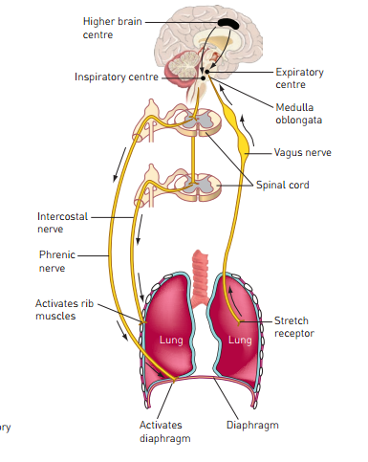
Mechanics of Breathing
Breathing uses muscles:
Diaphragm
Intercostal muscles
Use of these muscles needs nerve stimulation
Diaphragm: Phrenic nerve
Intercostal muscles: Intercostal nerves
Spinal and Intercostal nerves
originate from spinal cord at neck and thorax
Controlled by respiratory centre in medulla oblongata
Has expiratory centre and inspiratory centre
Learning Aim: Describe the nerve and muscle pathways involved in breathing.

Slide 5

Control of Rate of Breathing (Respiratory Rate)
O₂ and CO₂ carried in blood, concentrations affect breathing rate.
Respiratory Rate is mostly controlled by CO₂ concentration in plasma:
Note: Concentration of CO₂ affects H⁺ concentration. As CO₂ levels in the blood rise, more carbonic acid is produced, so more H⁺ becomes dissolved in the blood plasma, and the pH drops.
Remember: rising CO₂ levels are the stimulus for breathing, not falling O₂ levels, except in extreme circumstances.
Learning Aim: Discuss how CO₂ concentration impacts blood pH

Slide 6
Stimulus for Blood Gas Homeostasis: Carbon Dioxide Concentration
CO₂ that enters the bloodstream is carried in plasma:
as dissolved CO₂ ( approx. 10 %)
as dissolved carbonic acid: H⁺ + HCO₃– ( approx. 80 %)
a small amount is bound to RBC (10 %) but is not important in gas homeostasis
CO₂ is the major stimulus in regulation of gas homeostasis via respiratory rate.
Small rise in blood CO₂ → big difference in rate of breathing.
Can be detected as dissolved CO₂ or as concentration of H+ (pH).
***NOTE: CO₂ leads to H+ which means pH (low pH means more acidic)***
Learning Aim: Understand that CO₂ concentration and its effect on pH are the major stimulus for regulation of respiratory rate.

Slide 7
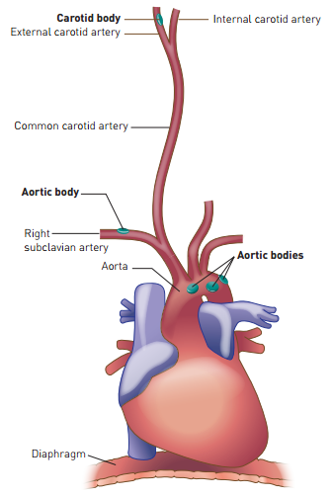
Receptors for regulation of blood gas concentration
Blood gas concentration is detected by chemoreceptors in the aorta and carotid artery. These then send signals to the medulla oblongata in the brain.
Chemoreceptors in the aortic body detect CO₂ and O₂ concentration
Chemoreceptors in the carotid body detect CO₂ concentration, H+ concentration (pH) and O₂ concentration
The medulla oblongata also has chemoreceptors that directly detect blood gas concentrations.
Chemoreceptors in the medulla oblongata detect H+ concentration (blood pH).
Learning Aim: Identify the major receptors and their locations for blood gas concentration and what each detects.

Slide 8
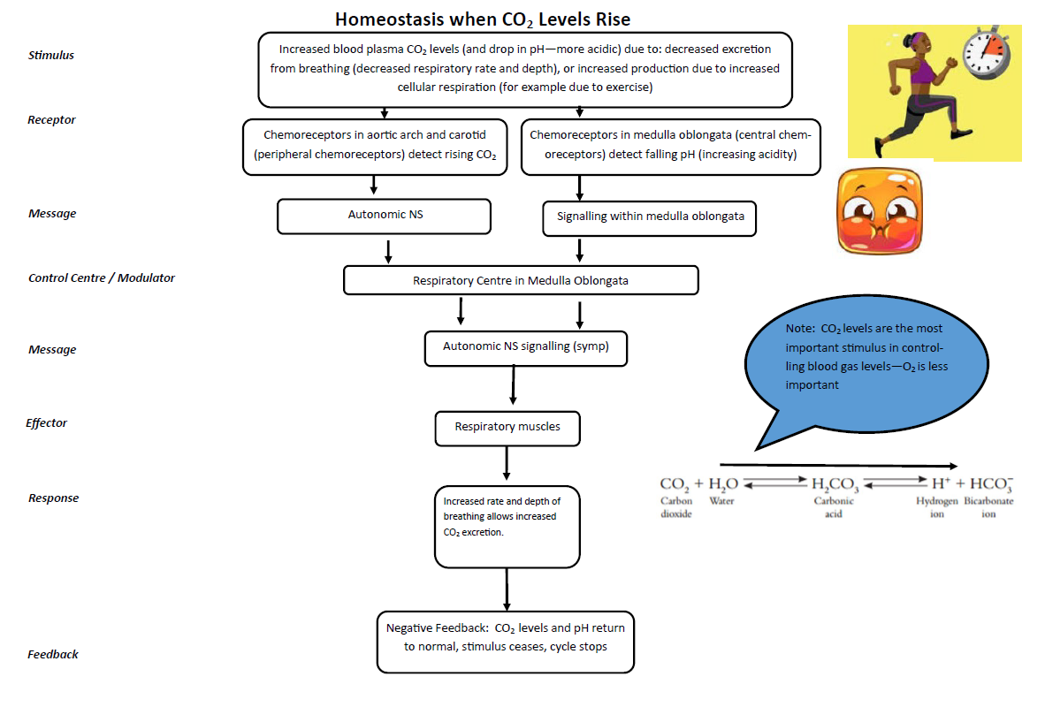
Learning Aim: Discuss how homeostasis is maintained when CO₂ levels rise.

Slide 9
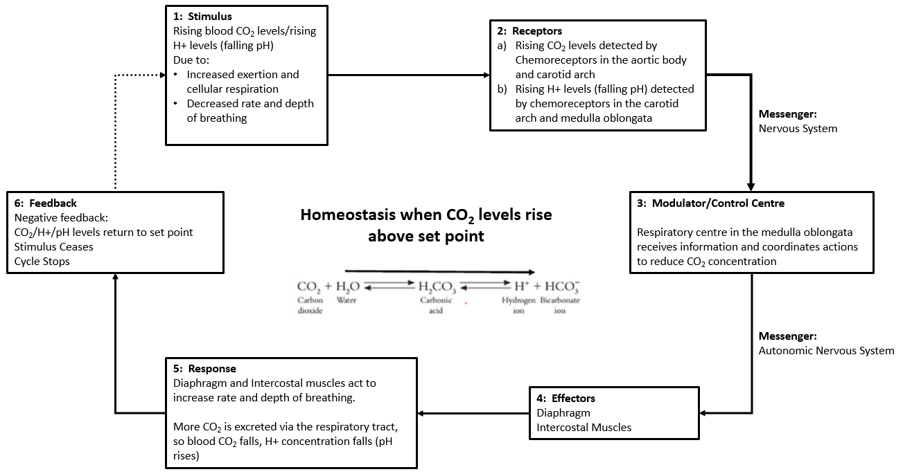
Learning Aim: Draw a detailed, annotated feedback loop (steady state control model) to show how homeostasis is maintained when CO₂ levels rise.

Slide 10
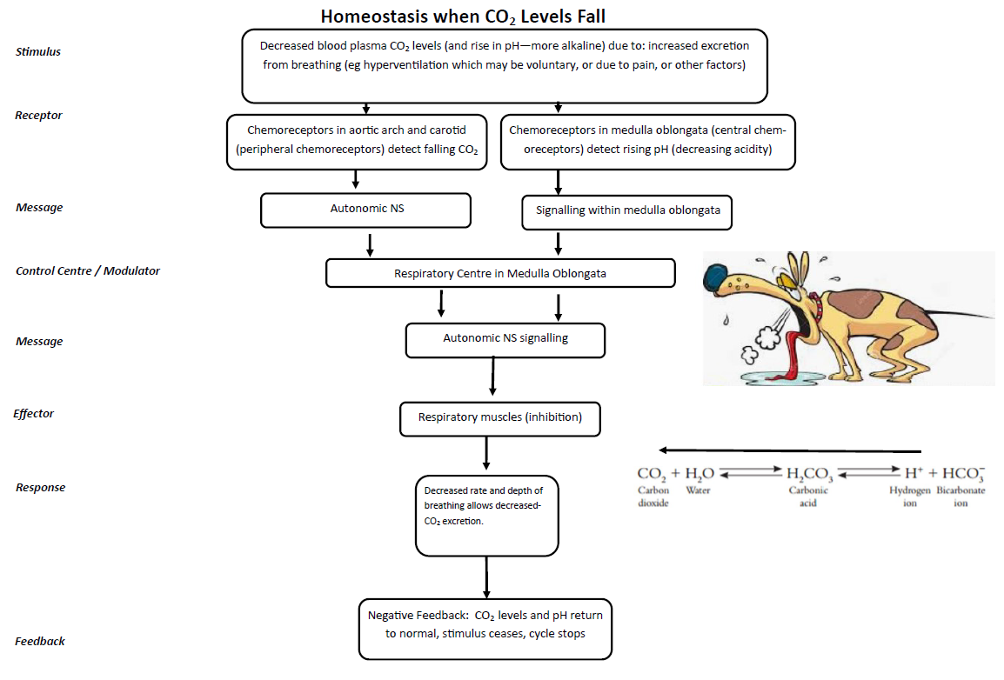
Learning Aim: Discuss how homeostasis is maintained when CO₂ levels fall.

Slide 11
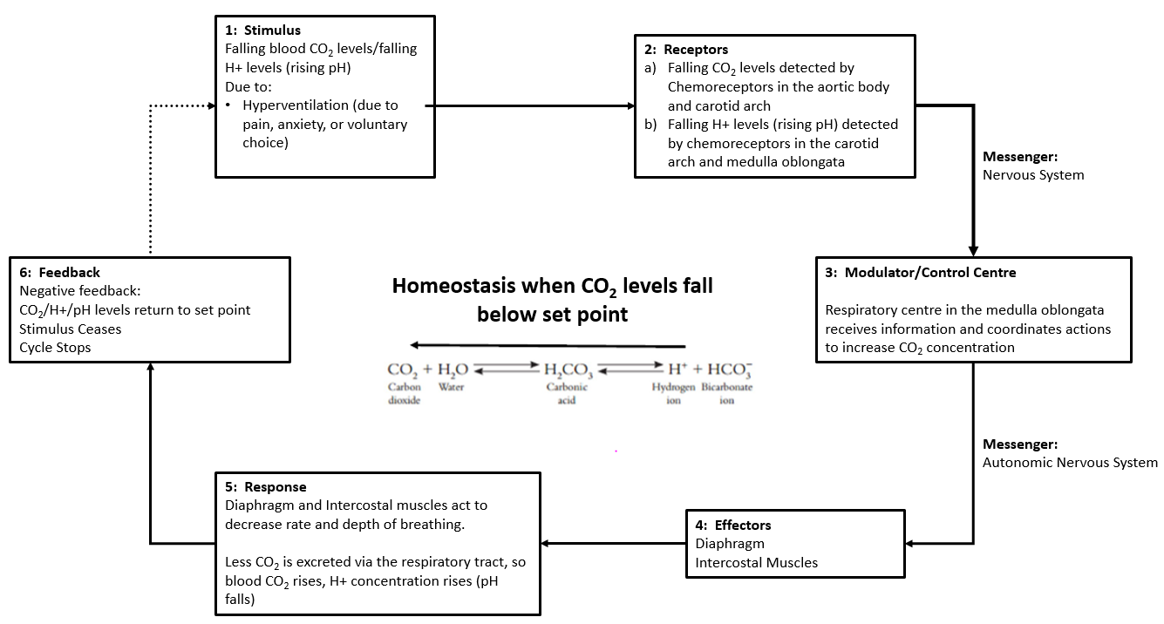
Learning Aim: Draw a detailed, annotated feedback loop (steady state control model) to show how homeostasis is maintained when CO₂ levels fall.

Slide 12
Oxygen concentration and regulation of blood gas levels
Concentration of O₂ in blood falls as it is consumed by cells.
Falling O₂ concentration only has small effect on breathing rate.
Plays little part in regulation of breathing, except if O2 concentration become EXTREMELY low:
1: Very low O₂ stimulates chemoreceptors:
Carotid and Aortic bodies
Medulla Oblongata
2: Nerve impulses transmitted to respiratory centre
3: Phrenic and Intercostal nerve stimulation increases breathing to restore O₂ levels.
This only occurs in extreme circumstances. Day to day, CO₂ is the stimulus for increased respiratory rate.
Learning Aim: Discuss the role of O₂ concentration in regulating blood gas levels and respiratory rate.

Slide 13
Voluntary Control of Breathing
Breathing can be voluntarily controlled – up to a point!
Voluntary control of breathing is necessary for speech.
Brain connections from cerebral cortex to spinal cord – bypasses respiratory centre in medulla oblongata.
We can voluntarily hold our breath, or voluntarily hyperventilate.
However: if we leave it too long:
Extreme Breath holding:
CO₂ levels in blood increase, blood becomes increasingly acidic.
Overwhelming urge to breathe
Combination of increasing acidity and falling O₂ causes unconsciousness and the medulla takes over.
Extreme Voluntary hyperventilation:
CO₂ levels in blood decrease, blood becomes increasingly alkaline.
Dizziness, then unconsciousness and medulla takes over.
Learning Aim: Describe the nerve pathways involved in voluntary control of breathing, and why voluntary control is limited.

Slide 14
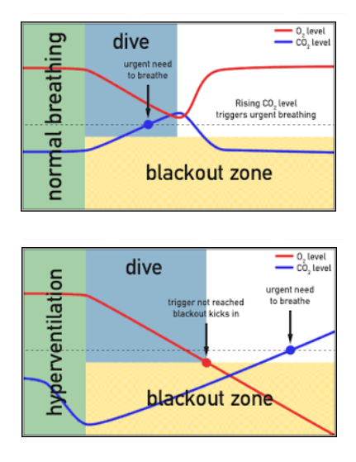
Shallow Water Blackout the dangers of hyperventilation before swimming or diving
Normal breathing:
Rising CO₂ levels trigger need to breathe.
This happens long before O₂ levels get low enough for blackout.
Hyperventilation
Artificially lowers CO₂ levels
Need to breathe is suppressed.
Strong urge to breathe may not occur until *after* O₂ blackout
If you’re underwater when that happens, you’ll drown.
Learning Aim: Discuss the physiological mechanisms involved in shallow water blackout.

Slide 15
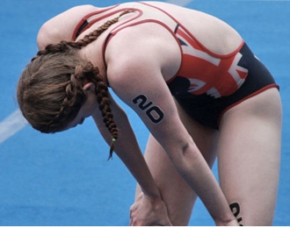
Exercise and Breathing – “Oxygen Debt”
Muscle contraction during exercise consumes O₂ and produces CO₂ waste.
If not enough O₂ available during exercise, muscles use anaerobic respiration, and build up lactic acid.
After exercise, the lactic acid is put back through aerobic respiration: Oxygen used to do this, and CO₂ is produced as waste, which keeps CO₂ levels high after exercise is finished.
This is why we keep puffing after exercise is finished – our body is supplying the oxygen needed to process lactic acid, and getting rid of the CO₂ being produced as the lactic acid is processed.
The same mechanisms involving chemoreceptors, medulla oblongata and nervous control of breathing apply: rate and depth of breathing increases to get rid of excess CO₂
Learning Aim: Discuss the physiological mechanisms involved in oxygen debt.

